Slide 1
Fault Diagnosis in Steel Plates using Machine Learning

Slide 2




Void Programmers
Maruthi Sankar Nanduri
Analyst
Monish Vallamkonda
Project Manger
Nikhil Gunti
Data Scientist
Anirud Vem
Data Scientist
2

Slide 3
Outline
Introduction and Purpose of Project
Data Preparation: Issues, Procedure, Justification
Visualization and Analysis
Model Building: Exploration, Building, Choosing
Results and Assessment
Original Vision versus Final Product
Conclusion: Recommendations and Lessons Learned

Slide 4
Introduction
The Heat-treated steel plates market is expected to exceed more than US$ 126 Billion by 2024
Every year 20% of the steel plates that are manufactured are faulty
Quality Control and Fault Diagnosis is an important aspect to enhance the quality of production and optimize the cost of product testing. Timely identification of the fault saves input cost
4

Slide 5
Purpose of the Project
Analysis into the factors responsible for faulty steel plates during the manufacturing process will enable the manufacturer to identify the issue in the plate early which saves lots of money
The core of this analysis will involve identifying the factors and classifying the faults in steel plates using Decision Tree, Random Forest, Neural Networks
5

Slide 6





Data Description
1941 rows
Fault is Target
UCI Machine Learning Repository
34 variables
6
Notes:
194

Slide 7
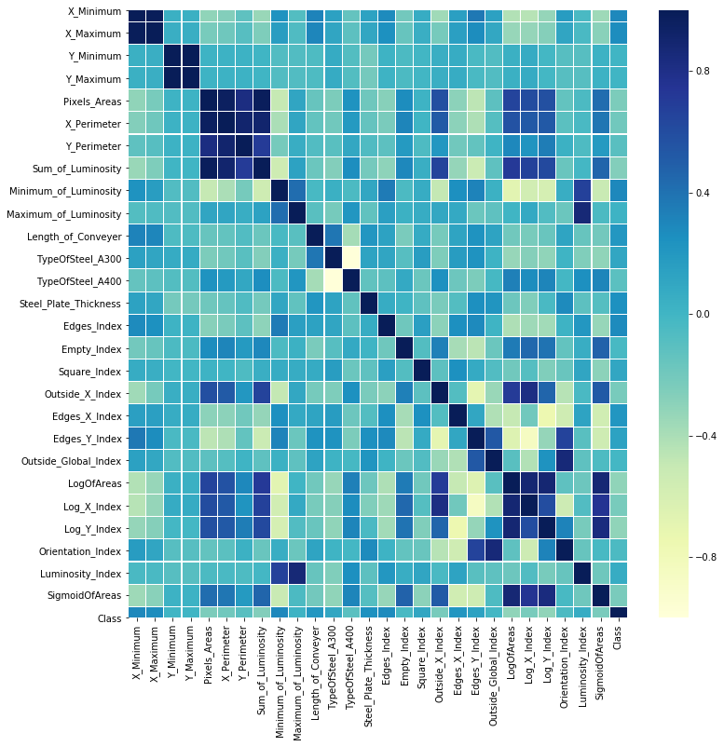
Data Preparation: Issues
Correlation Matrix
There are variables which are highly correlated
Few Variables are skewed
Target variable that define fault type are dummy coded as 7 different variables
7
Notes:
No problems in Data Access, Data Cleaning and Data Consolidation. All the data is checked and necessary steps were taken

Slide 8
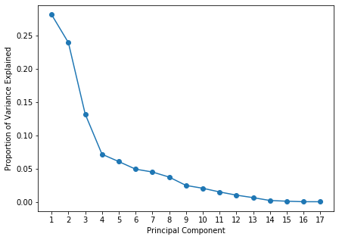
Data Preparation: Procedure
Reduced the total number of variables to 9 predictor variables from 27 using Principal Component Analysis(PCA)
All the target variables are one hot encoded into a single variable with 7 classes in it
Skewed variables are transformed using logarithmic transformation
PCA
8
Notes:
We have no issues or problems in Data Access, Data Cleaning and Data Consolidation as all the data is checked and necessary steps were taken

Slide 9
Data Preparation: Justification
All the correlated variables are reduced
All the variables which are skewed are transformed
By this it’s made sure that the data is not biased and ready for analysis which provides accurate results.
9
Notes:
We have no issues or problems in Data Access, Data Cleaning and Data Consolidation as all the data is checked and necessary steps were taken

Slide 10
Visualization and Analysis

Slide 11
Visualization and Analysis of Input Variables
11

Slide 12
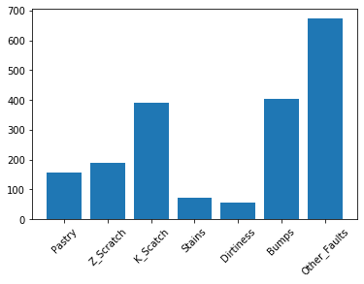
Visualization and Analysis of Target Variables
Pastry
Z_Scratch
K_Scratch
Stains
Dirtiness
Bumps
Other_Faults
Distribution of Defect types
12
12

Slide 13
Model Building

Slide 14
Models
Total 6 models were built
Data for modeling:
All independent variables
Variables selected from PCA and FA
Model types (3):
Decision Trees
Random Forest
Neural Network
14
Notes:
Being a classification problem, we came up with 3 supervised learning algorithms Decision Trees, Random Forest and Neural network. In total we built 6 models, all 3 models on two sets of data. Initially we ran models on all 17 independent variables, after performing principal component analysis and factor analysis number of variables are reduced to 9. We then performed the same models on this variable reduced data. We would like to compare the model performance before & after and see if PCA can affect on faulty steel prediction.

Slide 15

Decision Trees
Data partitions based on rules
Gini Index metrics as classification criteria
Easy interpretation of results
Most important variables for classifying the defects can be achieved
15
Notes:
The objective of this project is to correctly classify the steel plates into one of the 7 faulty types. Decision trees help us understand this classification pattern. Also, it has the major advantage of easy interpretation of results derived. Its output gives us the data partitions based on the rules to identify faulty plate. Here we used Gini index metrics as the classification criteria in splitting the tree. After obtaining data association rules, from top nodes where tree originates we could infer most important variables for classification.

Slide 16
Random Forest
Ensemble of 100 decision trees using bagging technique.
Random sampling of training data points – trees
Random subsets of features – nodes
Advantages: Best split of data, Bootstrap sample, Lower variance, Reduces overfitting
16
Notes:
Though decision trees has advantage of easy interpretation sometimes it has the problem of overfitting. In order to reduce overfitting, we used random forest as it is ensemble of the decision trees and also improves accuracy. Here we employed bagging technique for ensemble of 100 decision trees. For building trees, random sampling of training data points is done and for building nodes random subsets of features is considered. Advantages of random forest over decision tree includes less overfitting, better accuracy, best split of data so on..

Slide 17
Neural Network
It’s a black box model which is very difficult to interpret, increases accuracy and complexity.
Hyperparameters in choosing
1.Hidden Layers
2.Neurons
3.Activation Functions
Neural Net:
Activation Function : Relu
Hidden Layers: 3
Neurons: (50,50,50)
Auto Neural Net: Hidden Layers: 100
17
Notes:
Neural Network model famously known as black box model finds the end users difficult to interpret the functioning inside easily. The advantages of using this model includes better accuracy. For neural network model, we tried different combinations of hyperparameters like number of hidden layers, neurons, activation functions to optimize the model. Our final neural net architecture consists of 3 hidden layers with 50 neurons each and activation function used is RELU as it includes non linearity into function. We also ran Auto Neural network model approaching ideal model characteristics. Generally neural net models are meant to perform better in classification tasks if hyperparameters are tunes correctly.

Slide 18
Results & Assessments

Slide 19
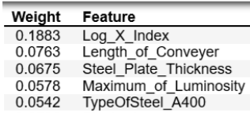
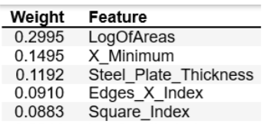
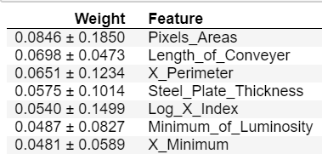
Results
Decision Trees Important Variables
Model 1: (Before PCA)
17 Independent variables
Important Variables:
Model 2: (After PCA)
9 Independent variables
Important Variables:
Random Forest Important Variables
19

Slide 20
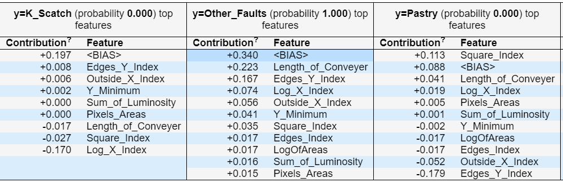
Decision Trees
Variables influencing in prediction of defect type
Actual test value: Other Faults
Predicted value: Other Faults
20

Slide 21
Assessment Metrics
Classification problem metrics:
Accuracy
Precision
Recall
F-1 score
How these metrics help us in model assessment?
21

Slide 22
Results & Assessment
Model Choice:
Random Forest Classifier →
Model results with all independent variables
Model | Accuracy | Precision | Recall | F-1 score
Decision Tree | 68% | 69% | 71% | 0.68
Random Forest | 74% | 74% | 74% | 0.74
Neural Networks | 71% | 72% | 71% | 0.71
Auto Neural Network | 72% | 73% | 72% | 0.72
Model results with 9 independent variables(After PCA)
Model | Accuracy | Precision | Recall | F-1 score
Decision Tree | 66% | 68% | 66% | 0.67
Random Forest | 74% | 75% | 74% | 0.75
Neural Networks | 69% | 67% | 69% | 0.68
Auto Neural Network | 68% | 67% | 68% | 0.67
Accuracy
No of parameters
Time & memory
22

Slide 23
Original Vision Vs Final Product
Original Vision was to Classify the Faults in Steel Plates with high accuracy using advanced ML methods
The vision was translated using Decision Tree, Random Forest and Neural Network algorithms.
The Machine Learning Algorithms classified the faults in steel plates with the given input variables and identified the most important features during the process.
The original vision is achieved successfully by predicting the faults in steel plates with an accuracy of 74%

Slide 24
Conclusions and Recommendations
Random Forest Model with reduced variables has the best accuracy
Key Features that explain faulty steel plates:
Steel plate thickness
Luminosity Index
Type of Steel
Dimensions of the steel plate
Surveillance on the quality of the key features mentioned reduces the faulty steel plates

Slide 25
Lessons Learnt
Skewed data influence the predictions in ML models
Principal Component Analysis can be performed to reduce complexity when there are large number of independent variables
Categorical variables can be modeled using Dummy coding (one-hot encoding)
Multi-Class target variables can be modeled using Decision Tree, Random Forest or Neural Networks
Neural Networks are difficult to interpret compared to the Tree-Based models but give good accuracy numbers

Slide 26
Thank You

